Slide 1


UPI Transaction Data Analysis
Focus: Transactions, Performance & Fraud Insights
Presented By:
Jivika Devraj Jadhav
Date:10.05.2026

Slide 2
Project Roadmap step 1: business understanding & analytical planning step 2: data understanding step 3: data cleaning & preparation step 4: exploratory data analysis (EDA) step 5: python analysis step 6: dashboard development in power BI step 7: final insights & business recommendations
Analytical Tools & Technologies The following tools will be used in this project: Microsoft excel used for initial data exploration and quick analysis Python (pandas, NumPy, matplotlib, seaborn) used for data cleaning, analysis, and visualization. Power BI used to build interactive dashboards and present insights. These tools will help in performing end-to-end data analysis.

Slide 3
Objective
Analyze UPI transaction performance
Identify trends in user behavior
Evaluate success, failure, and fraud rates
Provide actionable business insights

Slide 4
Executive Summary: Core Metrics
$4.24M
Total Transaction Value
92.14%
Success Rate
100K
Total Transactions
2.00%
Fraud Rate
5.87%
Failure Rate
1.99%
Pending Rate
System shows strong performance with high success rate

Slide 5
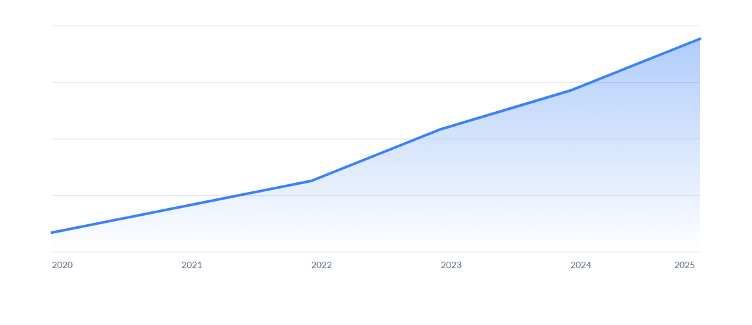
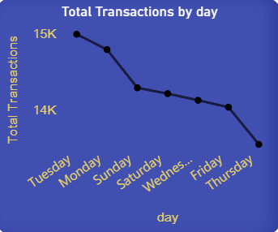
Historical Growth Trajectory
Weekdays see higher volume (Mon–Fri) vs. weekends, Maximum Transaction made on Monday and Tuesday.
Continuous upward trend with significant acceleration observed post-2023, reflecting strong platform adoption.
Indicates rapid UPI adoption and scalability

Slide 6
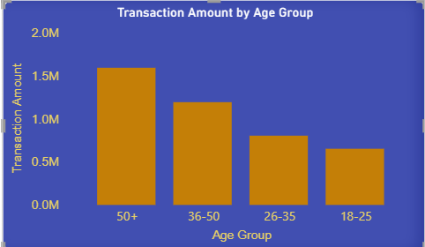
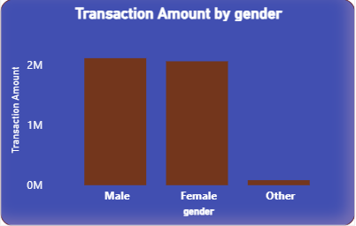
User Demographics & Value Distribution
Gender & Behaviour
Male users contribute slightly more to the total volume (52%). Customer retention follows a seasonal trend, reaching its peak in July (~70%)
Age Segment Analysis
The 50+ age group represents the highest transaction value, despite not being the largest volume segment. Younger segments (18-25) show high frequency but lower individual transaction ticket sizes.

Slide 7
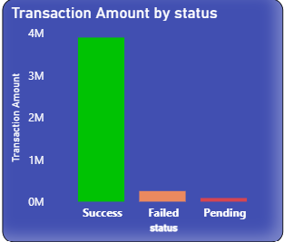
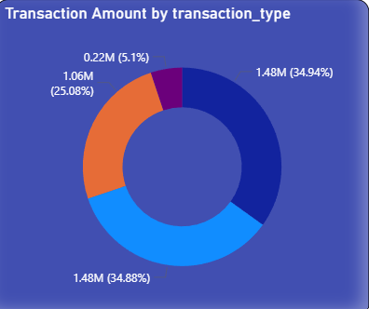
UPI Transaction Distribution Analysis
P2P transfers (Send/Receive) dominate at 70% of total volume (~$2.96M), while Merchant Payments ($1.06M) represent the primary commercial driver.
“Transaction system is highly efficient with a dominant success rate and minimal failures or delays.

Slide 8
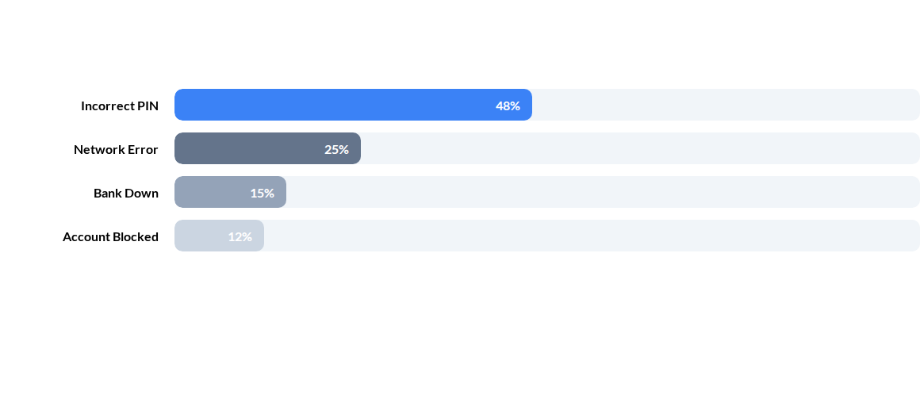
Technical Performance Analysis
Analysis of 5,870 failed transactions reveals critical bottlenecks
Primary Failure Drivers
Incorrect PIN: Leading cause of user-end failure.
Network Latency: Infrastructure challenges causing timeouts.
Bank Downtime: Third-party institutional dependencies.
Account Blocks: Security-triggered transaction halts.

Slide 9
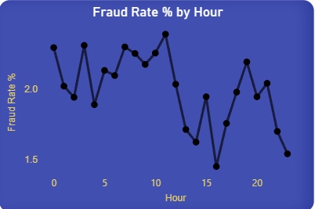
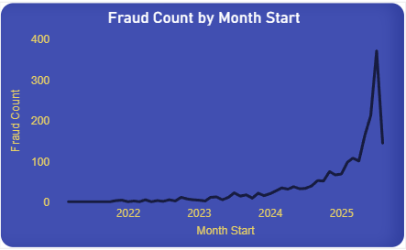

Fraud Overview
Fraud Overview
Total Fraud Count: 2000
Fraud Rate: ~2%
Fraud Amount: 84.71K
➡️ Fraud is controlled but still significant
Noticeable spikes during late-night / off-peak hours
Insight Fraudsters exploit low monitoring periods.
Action:
Enable stricter fraud rules during night hours
Real-time alerts & anomaly detection

Slide 10
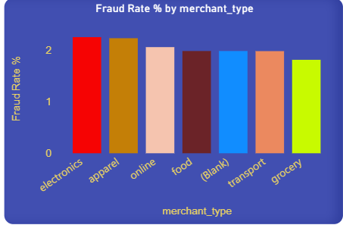
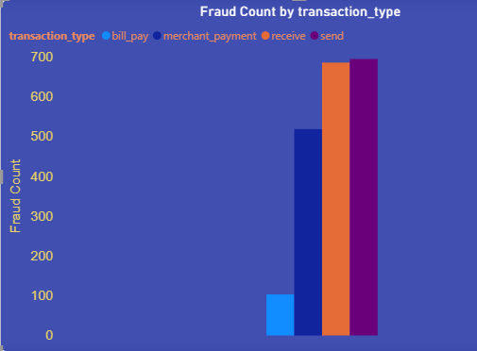
Fraud Dynamics and Distribution
Categories like Apparel, Electronics, Online dominate transaction volume
Some categories show relatively higher fraud share
Action:
Identify high-risk merchant categories
Perform periodic audits and stricter onboarding checks
Send & Receive transactions have highest fraud count
Bill payments show lowest fraud
Action:
Add verification for send/receive transactions
Limit high-value transfers

Slide 11
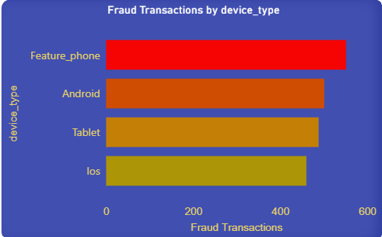
Device-Level Analysis
Device Platform | Total Volume | Fraud Transactions | Risk Index
Feature Phone | 25596 | 551 | Very High
Android | 25145 | 501 | High
Tablet | 24476 | 488 | Medium
iOS | 24783 | 460 | Low
Feature phones have highest fraud transactions
Action:
Apply extra authentication for feature phones
introduce additional authentication (OTP / biometric)
*Android remains the primary target for malicious activity due to platform fragmentation and sideloading capabilities.

Slide 12
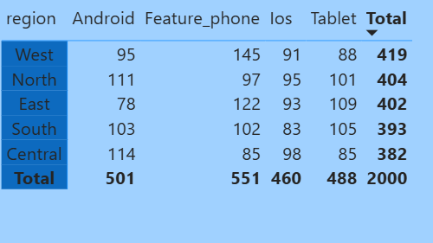
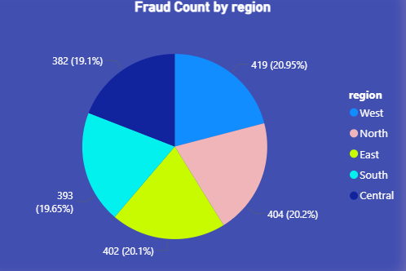
REGIONAL PERFORMANCE
From a business perspective, this analysis suggests that fraud prevention strategies should focus more on Feature phone users and high-fraud regions such as West and North.
Additional security measures like stronger authentication, transaction monitoring, and customer awareness campaigns can help reduce fraud occurrence across these segments.”

Slide 13
DATA INSIGHS SUMMARY
Reliability: 92.14% success rate is strong but failure rate (5.87%) indicates infrastructure strain.
4. User Experience Focus: "Incorrect PIN" failures suggest a need for biometric authentication (FaceID/Fingerprint) integration.
2. Demographic Shift: High-value transactions are dominated by older users, while volume is driven by younger cohorts.
3. Security Priority: 2% fraud rate is manageable but necessitates immediate blocks on rooted devices.
3. Growth Engine: Monday/Tuesday peaks suggest high weekly business settlement activity.
6. Regional Strategy: Tailor infrastructure expansion to West/South hubs to meet demand.

Slide 14
Thank you
Any Questions

